Slide 1
Heart Disease
Prediction by Heartbreakers
Alex, Ben, Braydon and Ekta

Slide 2
Wholeheartedly Welcome!
Data Source: https://www.kaggle.com/datasets/rishidamarla/heart-disease-prediction
Dataset has 14 columns
FBS- fasting blood sugar > 120 mg/dl
Thallium: 0 = normal; 1 = fixed defect; 2 = reversable defect
EKG results: electrocardiographic results 0: normal -- Value 1: having ST-T wave abnormality (T wave inversions and/or ST elevation or depression of > 0.05 mV)
-- Value 2: showing probable or definite left ventricular hypertrophy by Estes' criteria
ST Depression: ST depression induced by exercise relative to rest
Exercise Angina: 1 = yes; 0 = no (Chest pain when you exercise)
Heart Disease: used to train the data
Notes:
Ekta can Introduce dataset and hypothesis
Hypothesis:
The hypothesis is that the presence of heart disease in patients is correlated with common symptoms and factors such as Age, Sex, Heart Rate and more.
It is anticipated that we will achieve greater accuracy if the fields identified with significant discrepancies; between heart disease presence and absence; are implemented for the machine learning process.

Slide 3
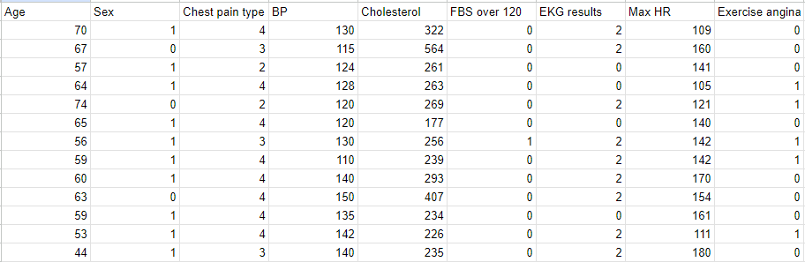
Wholeheartedly Welcome!

Slide 4
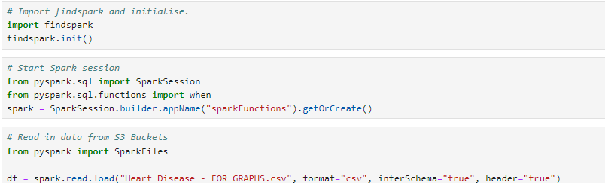
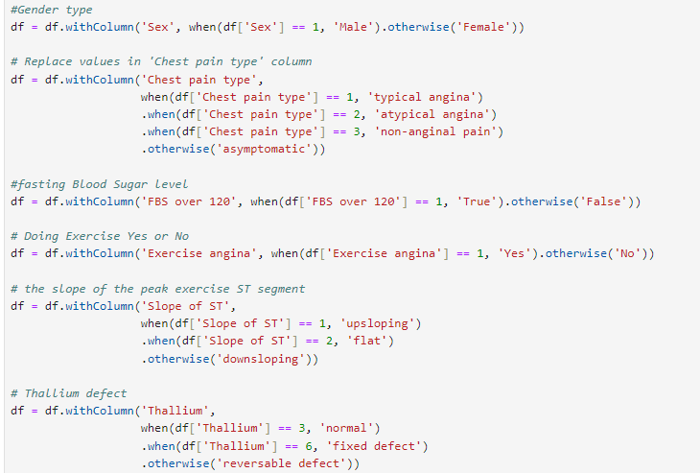
Hypothesis:
Notes:
Braydon’s Graphs and initial findings

Slide 5
Braydon
Exploratory Analysis
Guiding the research
Notes:
Braydon’s Graphs and initial findings

Slide 6
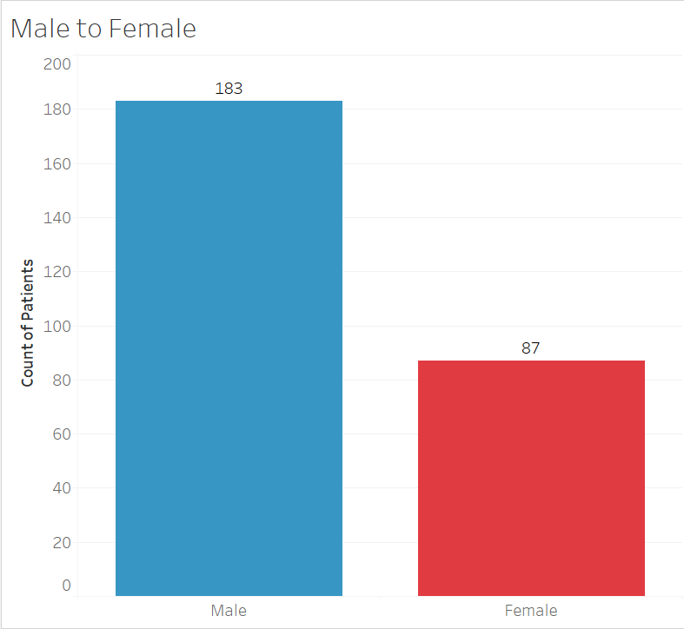
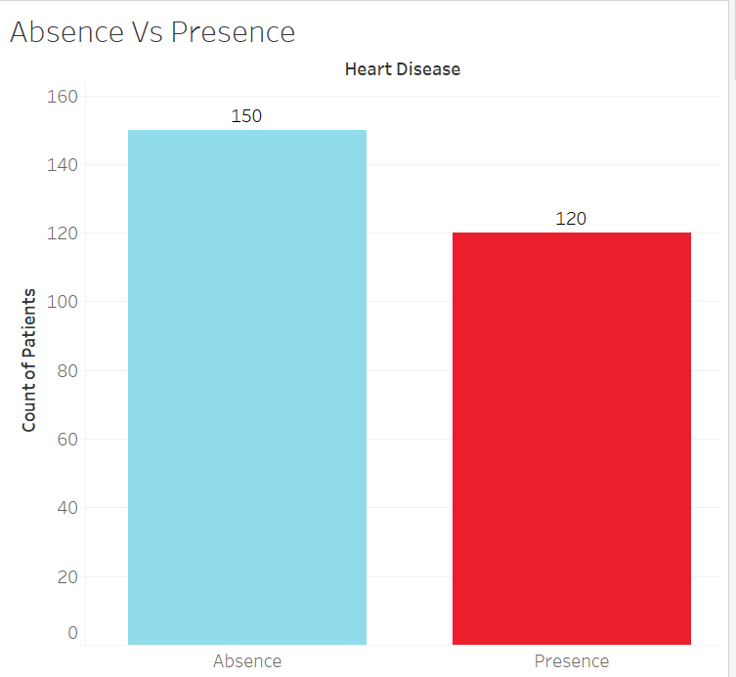
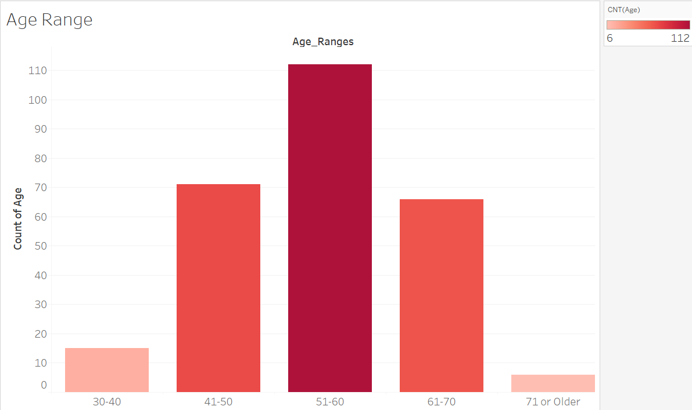
Dataset Breakdown
Acknowledgement of the dataset population.
Patients with heart disease present: 120
Patients male to female: 183:87
Aged 30 to 80 (Predominantly mid 50’s)
All participants had some form of chest pain.
Visually represent the data, grouped by Heart Disease status.
Analyse & Identify significant fields

Slide 7
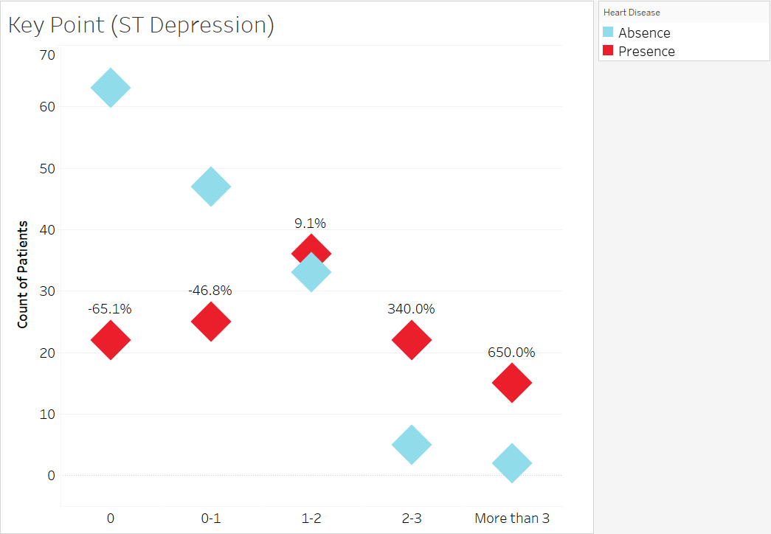
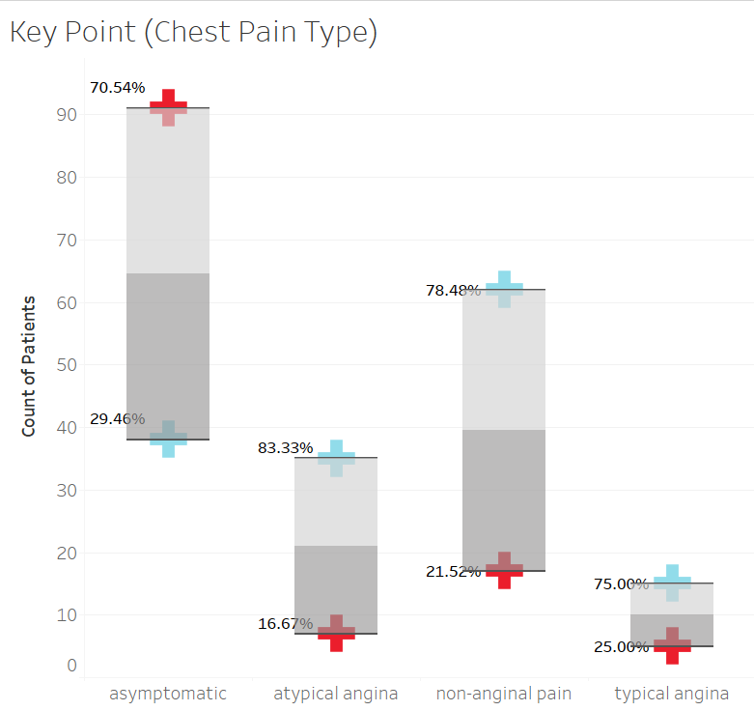

Key Findings
Key trends to identify were:
Large discrepancies between Heart disease groups.
Whether there is a correlation between groups within each field
Through analysis, it became apparent which fields would be important for the machine learning process.
Three of these fields in particular were Thallium, ST Depression, Chest Pain Type & Exercise Angina

Slide 8
Ben
Decision Trees and KNN
Notes:
Ben will explain decision trees and KNN

Slide 9
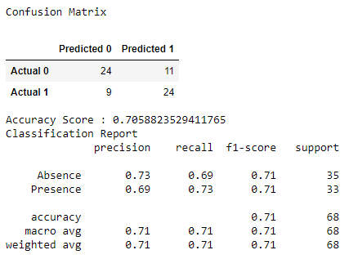
Decision Tree
Notes:
Accuracy fluctuates between 66 to 72%.

Slide 10
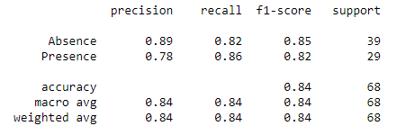
KNN Model

Slide 11
Ekta
Random Forest and Feature Importance Visualisation
Notes:
Ekta will explain random forests

Slide 12
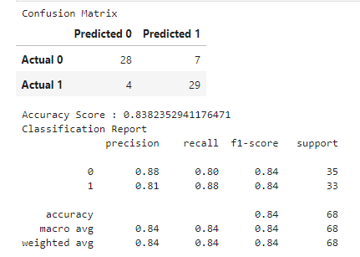
Accuracy Score

Slide 13
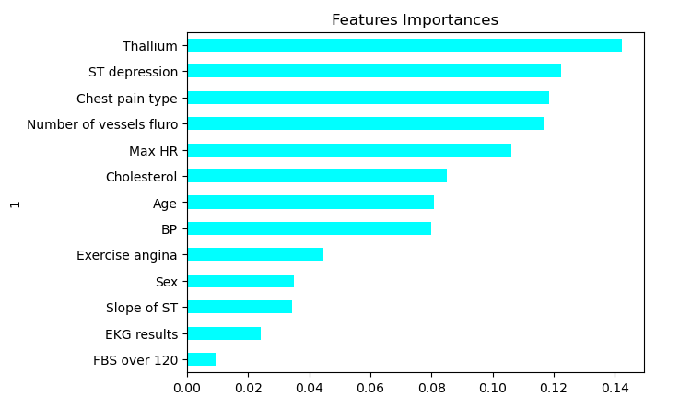
Visualize the features by importance
Importance ranking suggests that factors such as thallium results, ST depression, chest pain type, and the number of vessels visible during a fluoroscopy procedure are particularly influential in predicting heart disease, while other factors such as age, cholesterol levels, and blood pressure also play significant roles.

Slide 14
Alex
Data Cleaning
The Neural Network
Notes:
Alex will explain his many, many, many attempts and the results for the neural network model

Slide 15
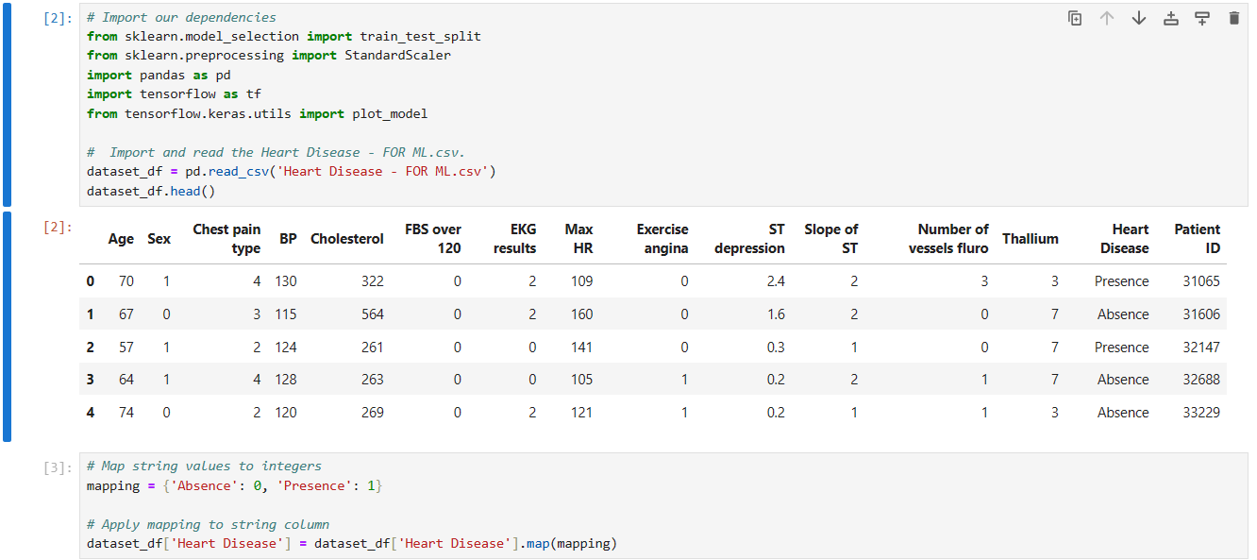
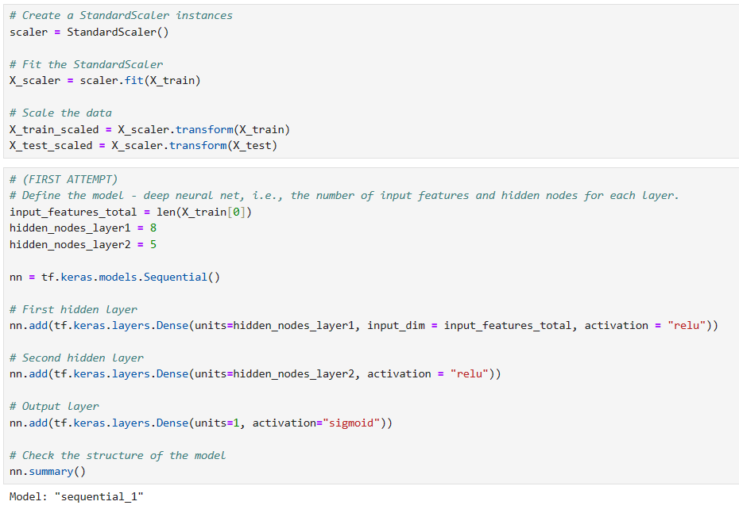
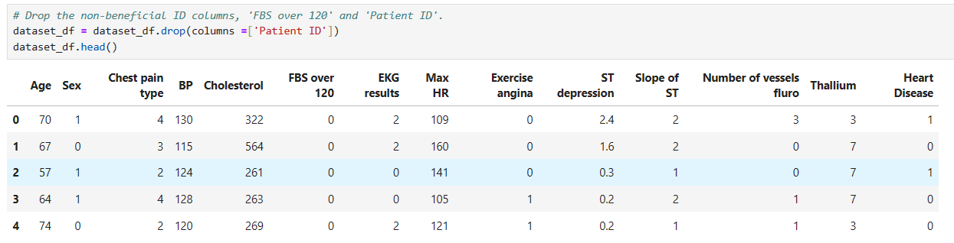
The Neural Network
Achieving the highest Accuracy possible

Slide 16
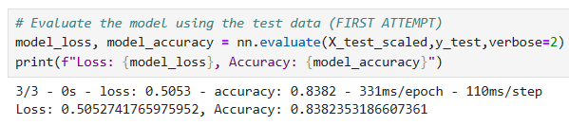
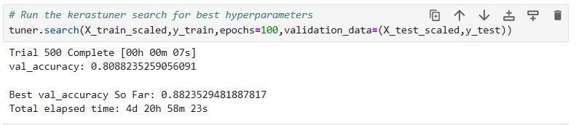
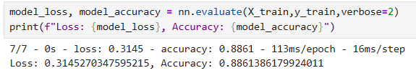
After removing the ‘Patient ID’ column in order to reduce the noise
Using a Kerastuner test after removing ‘Patient ID’
Using the Features Importance results removing the lowest importance columns - ‘FBS over 120’, ‘EKG results’, ‘Sex’ as well as removing ‘Patient ID to reduce the noise.

Slide 17
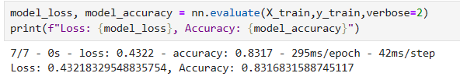
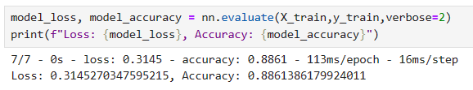
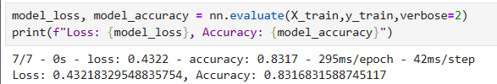
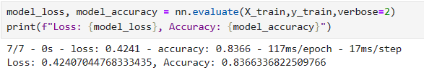
Following the visualisation results by only testing columns ‘Exercise angina’, ST depression’, ‘‘Thallium’ and ‘Chest pain type’
Removing ‘FBS over 120’, ‘EKG results’, ‘Sex’ and ‘Patient ID’
Following the visualisation results by only testing columns ‘Exercise angina’, ‘ST depression’, ‘Chest Pain Type’ and ‘Thallium’
Doing the opposite of the visualisations by testing all columns other than ‘Exercise angina’, ST depression’ and ‘Thallium

Slide 18
Conclusion

